Slide 1


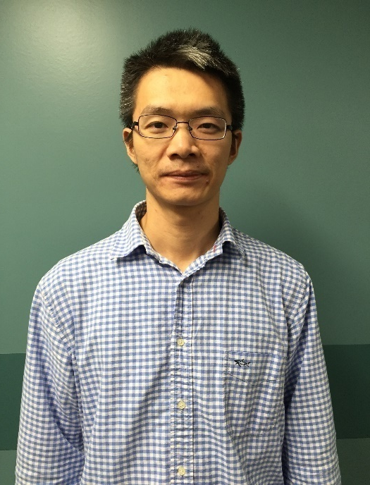
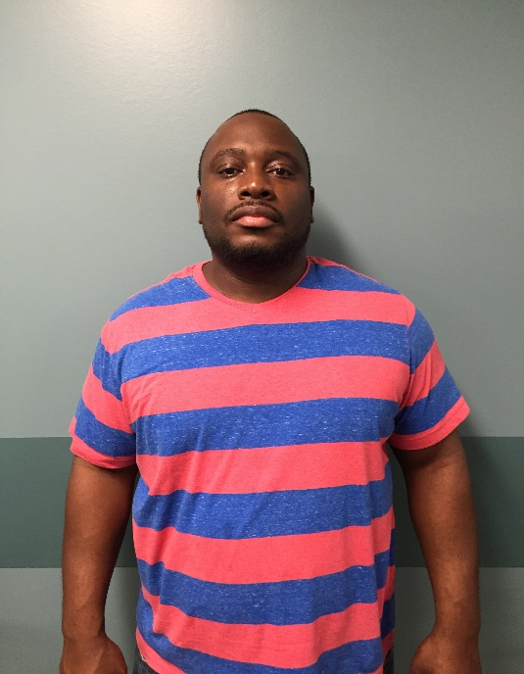
ERP Solutions Inc C1 CPSC 8985 Seminar Team 1
Ujjwal Kumar Chowdary Konka
“UJ”
ChengPeng Li
“Paul”
Bilal Hasan Bailey
“Bilal”
Venkata siva
“Siva”

Slide 2
Project Overview
The objective is to design and develop an application which will integrate all the functions in a company to a single computer system that can serve all the required functional needs.
To create an application which can be leverage by all functions to make decisions as well as identify performance gaps.

Slide 3
Benefits of ERP
Reliable Information Access
One central database with no duplication of data
E Commerce, E business
Improved Scalability
Easy upgrades
Cost reduction
Improved Customer service and satisfaction

Slide 4
Risk Assessment and Management
POTENTIAL RISK | ACTION TO MANAGE RISK
The database may run out of space | Upgrade the database
Database may crash | Maintain regular backups and maintain duplex system(production and development database)
SQL Injection | To overcome the problems of SQL injection we have used better coding by making use of prepared statements.

Slide 5
Critical Success Factors
Clear understanding – strategic goals
Data accuracy
Cope with technical issues
Organizational commitment to change
Great implementation team

Slide 6
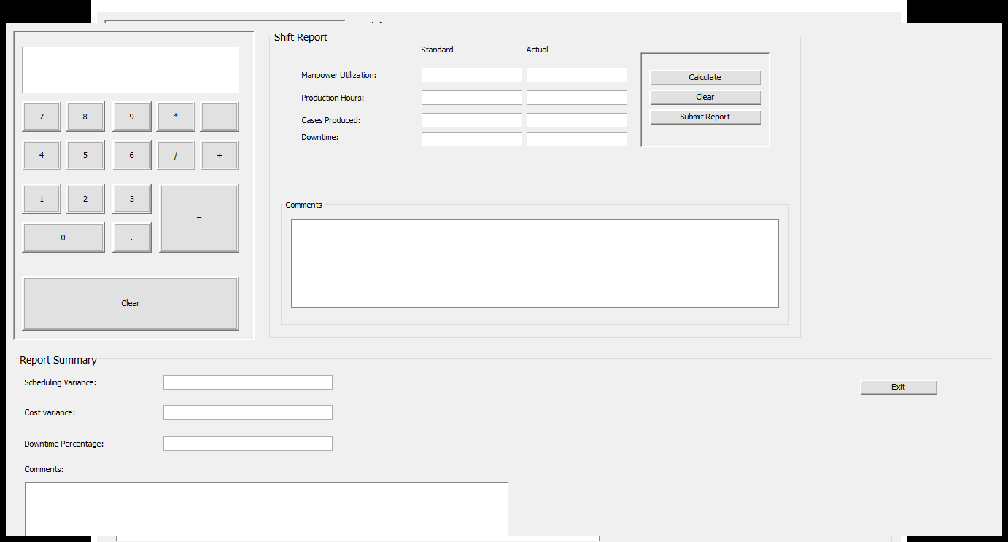
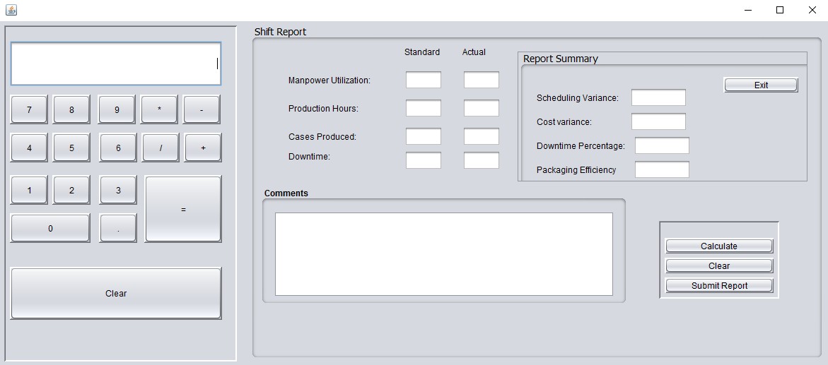
Design layouts
Old Design Layout
New Design Layout

Slide 7
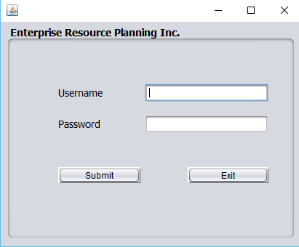
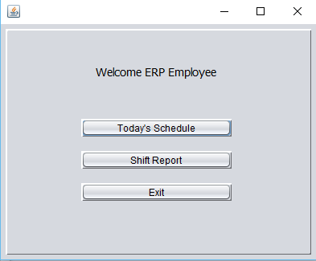
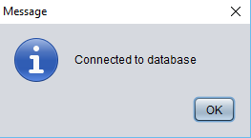
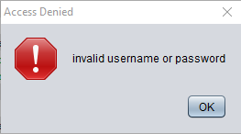
Design View
When the user gives his login credentials he will get pop up window like connected to database and he gets the welcome page of ERP which contains three tabs namely today’s schedule, shift report and exit.

Slide 8
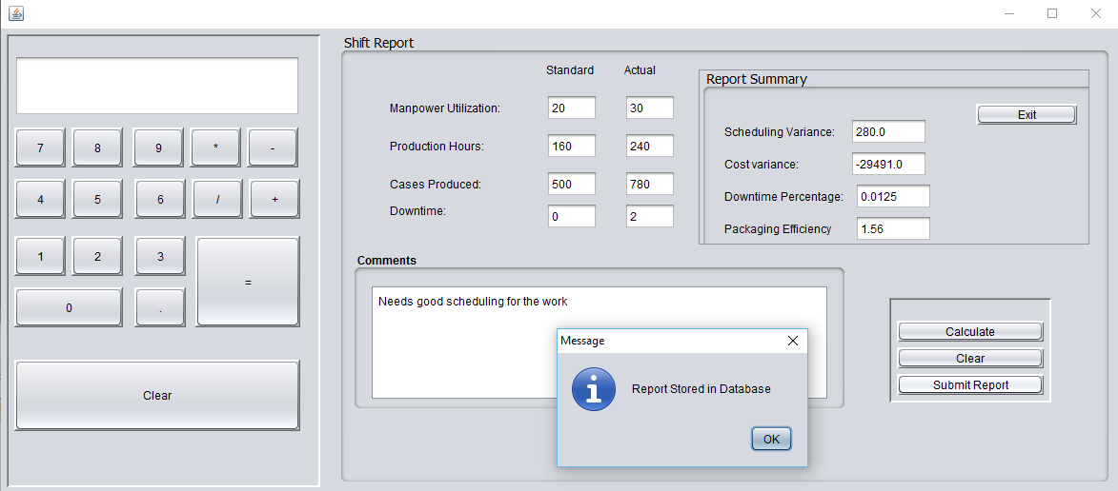
Design View
Shift report exhibits the module that contains an on screen calculator.
Manpower utilization, production hours, cases produced, downtime are noted as standard schedule and actual workdone in real time.
After entering the data in standard and actual fields of shift report and when the user clicks on calculate to get the scheduling variance, cost variance, downtime percentage and packaging efficiency.
All the calculated values can be stored in database when the user clicks on submit report button.

Slide 9
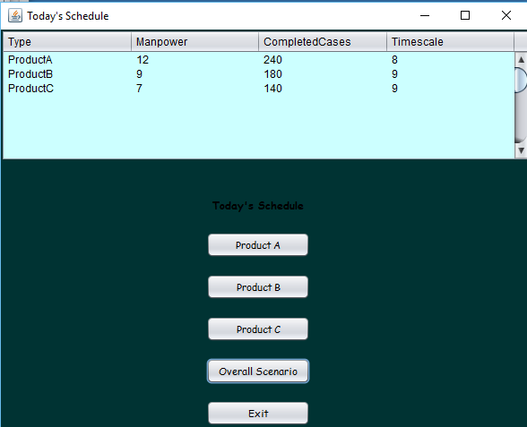
Design View
Today’s schedule button displays the what type of product work is done, how much manpower is used, no. of cases completed and time elapsed.
One can also view individual products information by clicking on respective products namely product A, product B and product C.
The user can see the whole scenario by clicking on overall scenario button and he can terminate using EXIT button.

Slide 10


